Slide 1
significance of Naam to auditory homeostasis and auditory circadian rhythms in Drosophila melanogaster
muhammad shaikh

Slide 2
significance of Naam to auditory homeostasis and auditory circadian rhythms in Drosophila melanogaster
Notes:
In terms of background, four things to explain…

Slide 3
significance of Naam to auditory homeostasis and auditory circadian rhythms in Drosophila melanogaster
Notes:
Let’s start with the easiest:

Slide 4
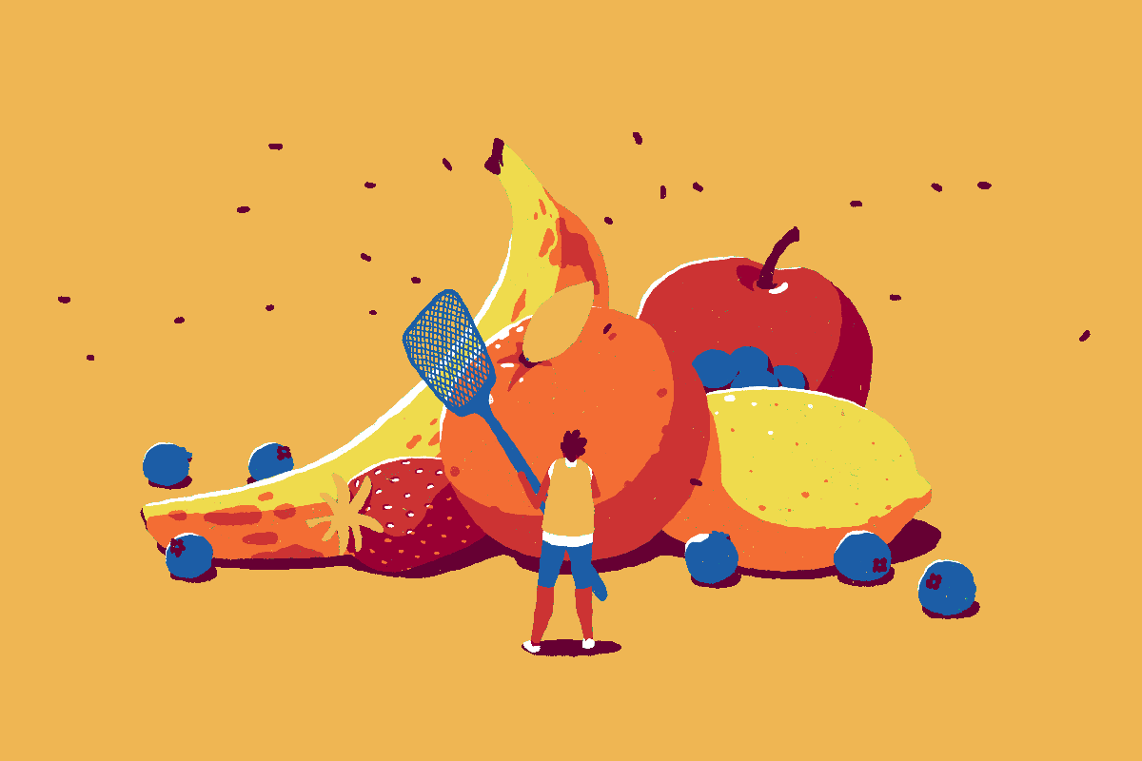
(2022). at <https://www.washingtonpost.com/food/2022/05/16/fruit-flies-trap-prevent/>
Notes:
Fruit flies! Why fruit flies? 1. practical reasons: easy & cheap to maintain, don’t require much space, fast life cycle. 2. expediency: Gal4/UAS RNAi lines, small genome, highly analogous to human

Slide 5
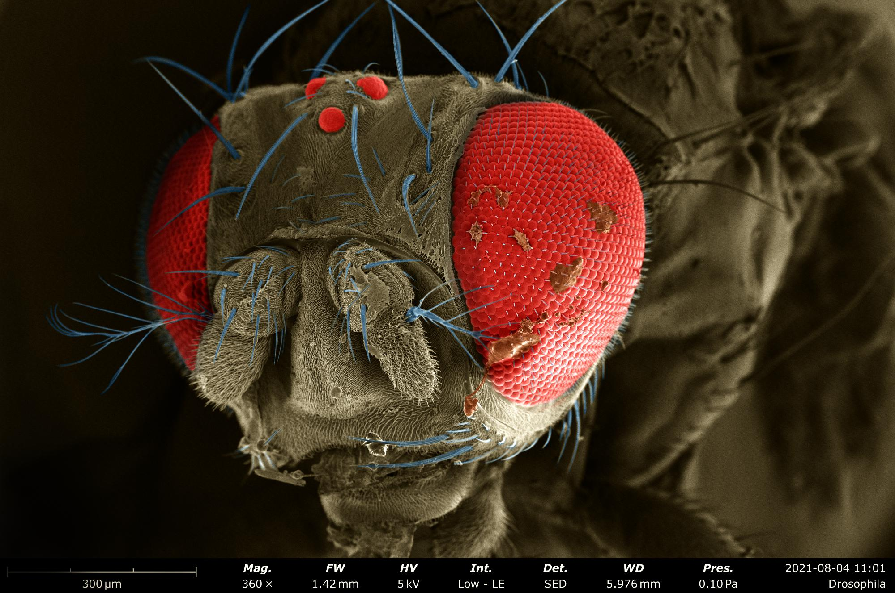
Reddit.com (2022). at <https://www.reddit.com/r/microscopy/comments/p5ff9r/drosophila_melanogaster_under_the_electron/>

Slide 6
Reddit.com (2022). at <https://www.reddit.com/r/microscopy/comments/p5ff9r/drosophila_melanogaster_under_the_electron/>

Slide 7
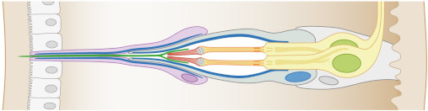
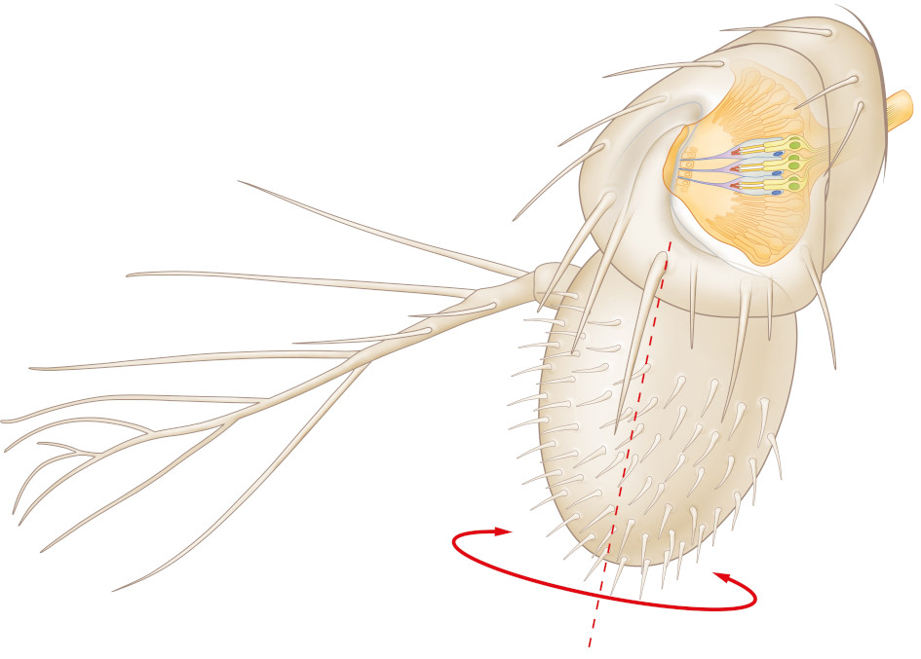
antennal anatomy Keder, A. et al. Homeostatic maintenance and age-related functional decline in the Drosophila ear. Sci Rep 10, 7431 (2020)

Slide 8
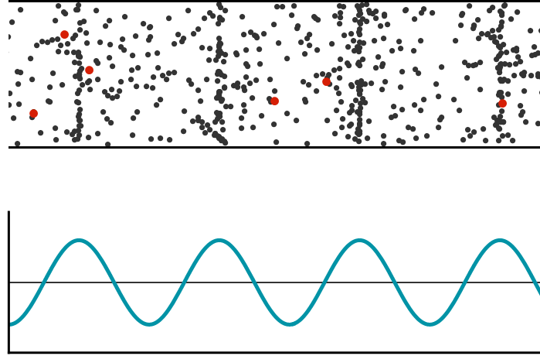
Waves and Light | Brilliant Math & Science Practice Problems. Brilliant.org (2022). at <https://brilliant.org/practice/wave-anatomy-2/>

Slide 10
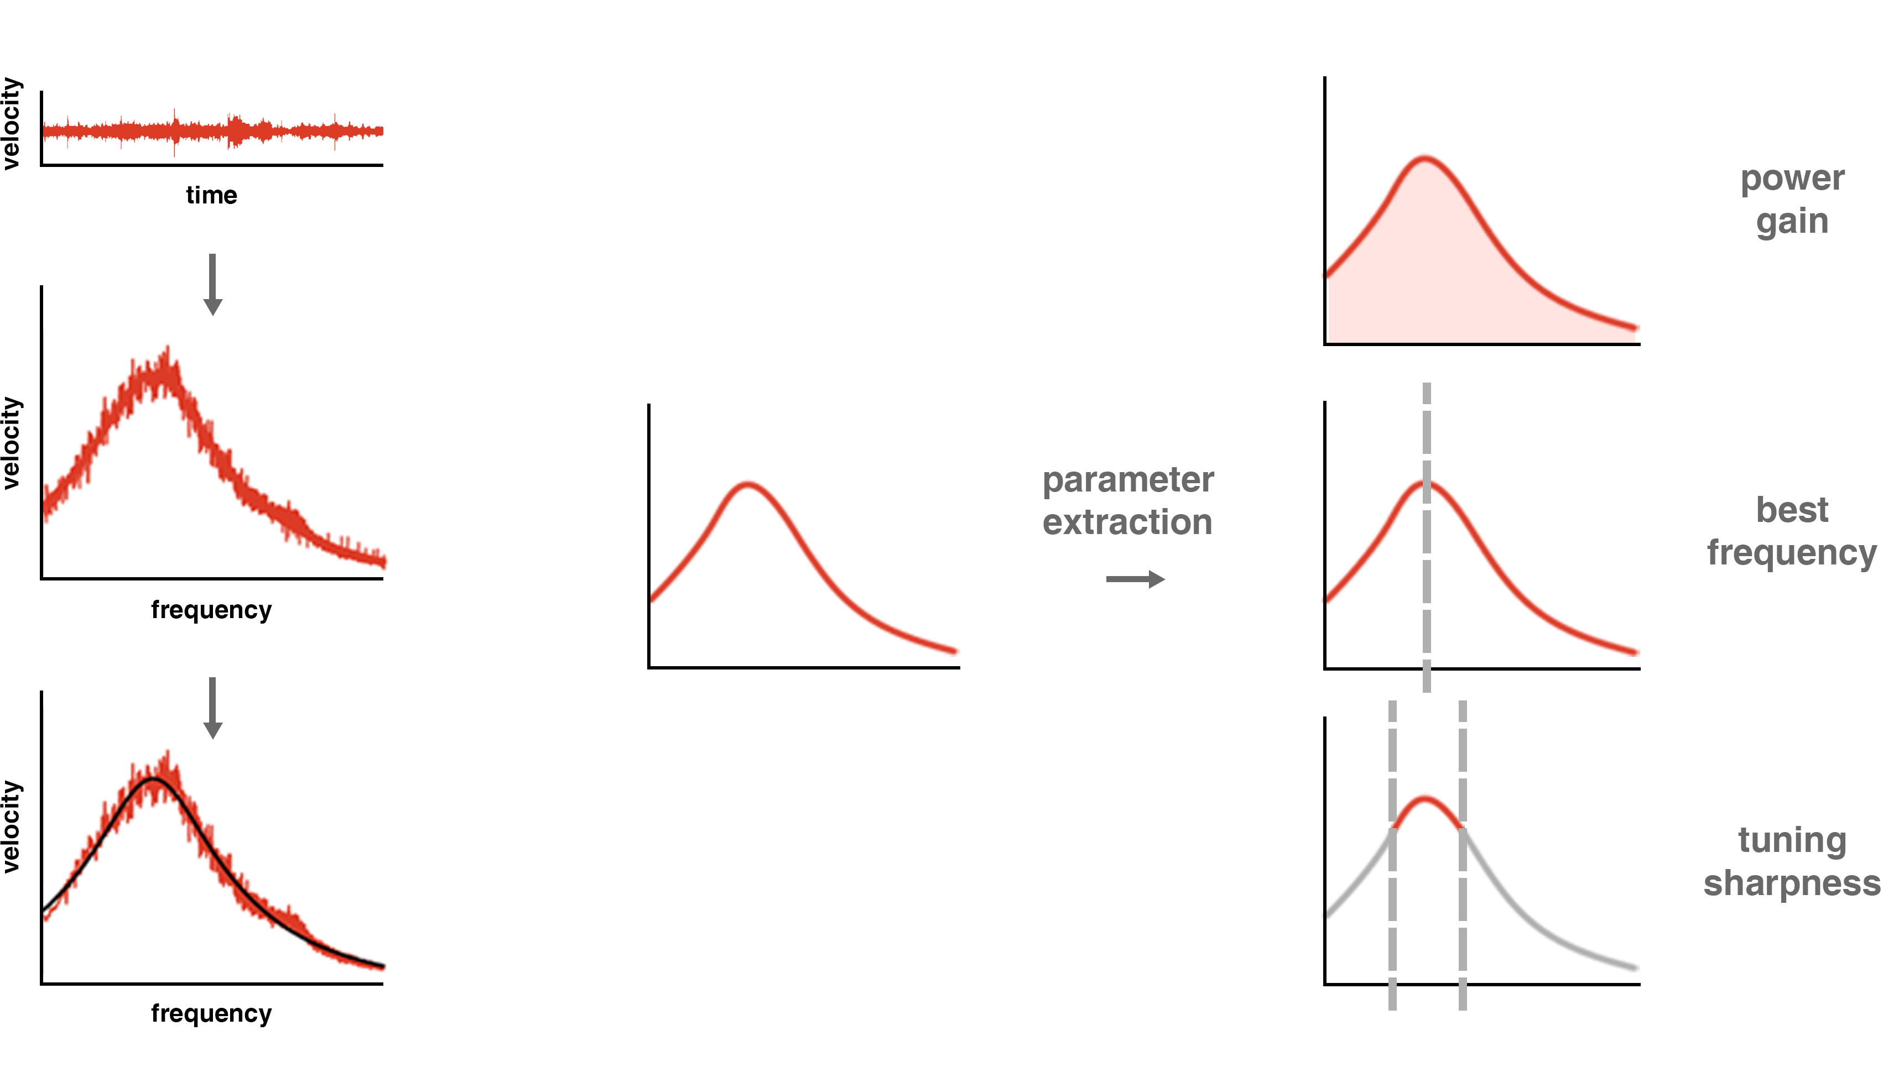
velocity
time

Slide 12
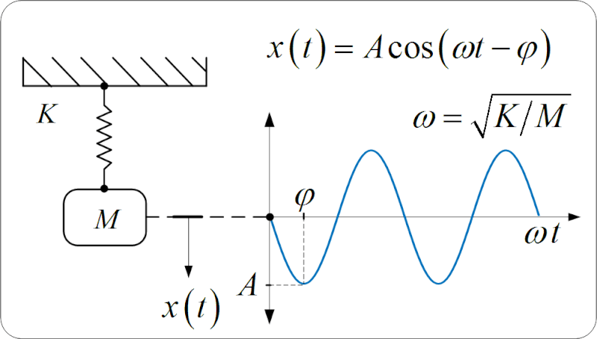
Ithkuil/Physics - Wikiversity. En.wikiversity.org (2022). at <https://en.wikiversity.org/wiki/Ithkuil/Physics>

Slide 13
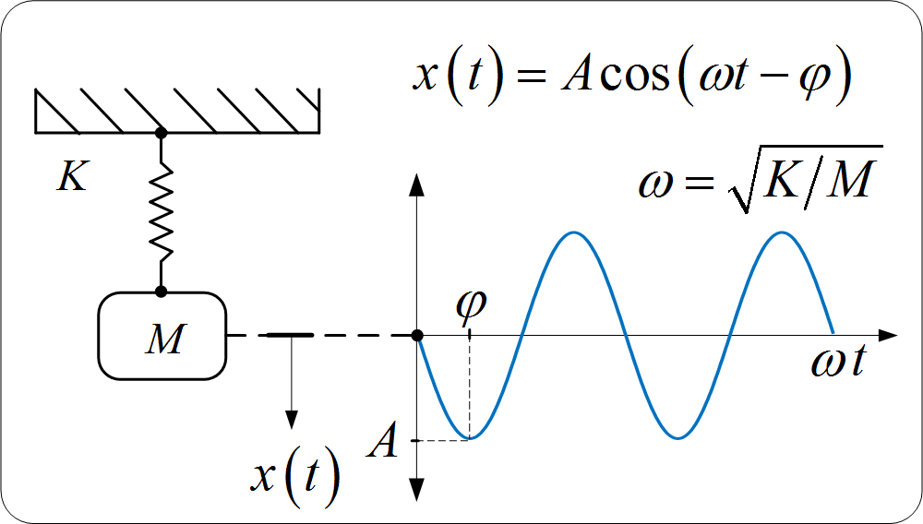
Ithkuil/Physics - Wikiversity. En.wikiversity.org (2022). at <https://en.wikiversity.org/wiki/Ithkuil/Physics>

Slide 14
neurons vary tension on the sound receiver via dynein motors Albert, J. & Kozlov, A. Comparative Aspects of Hearing in Vertebrates and Insects with Antennal Ears. Current Biology 26, R1050-R1061 (2016).
Notes:
Active process changes antennal stiffness. Relevant for courtship

Slide 17
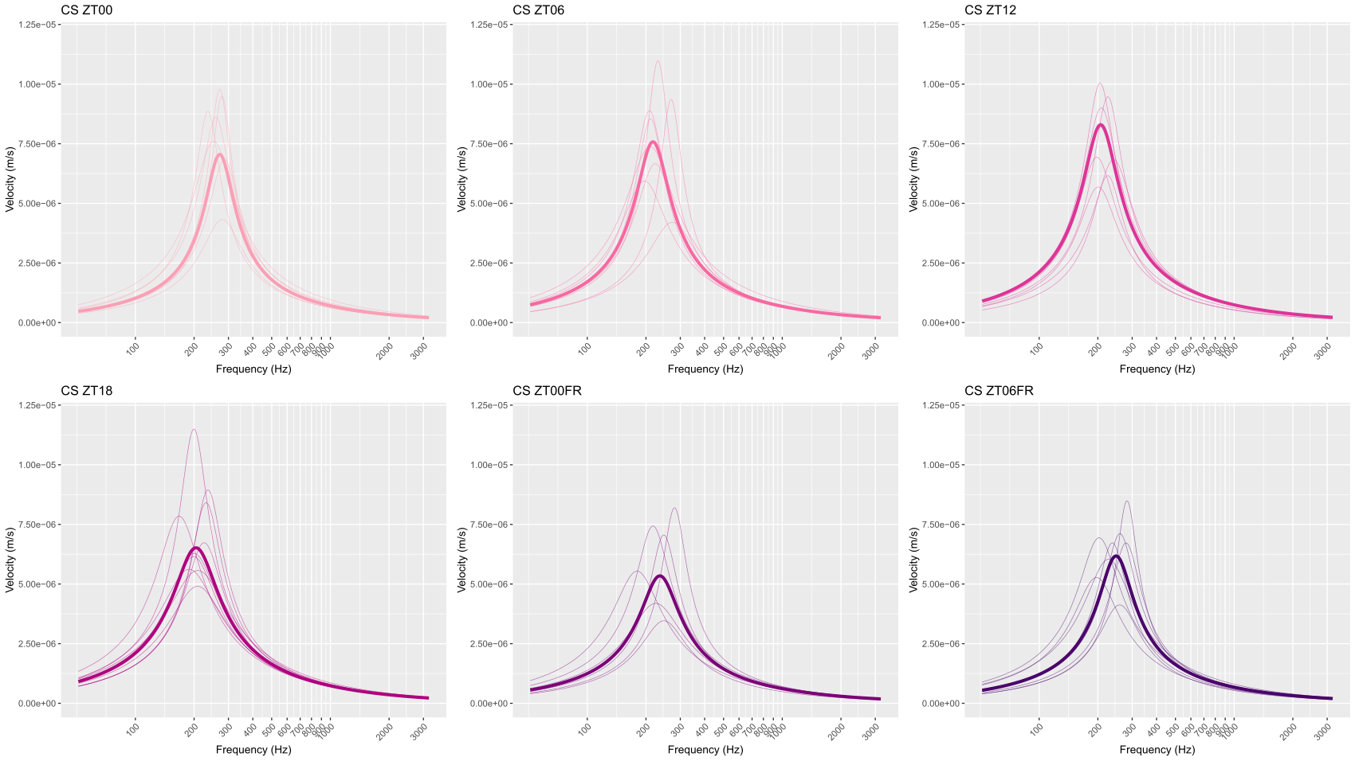
Notes:
12a, 6a, 12p, 6p. You can see that something in the antenna is changing. They’re different in three ways; I’m going to show you two of them.

Slide 20


Dribbble (2022). at <https://dribbble.com/shots/5262117-Among-Trees-3>
Steamcommunity.com (2022). at <https://steamcommunity.com/app/897730>

Slide 21
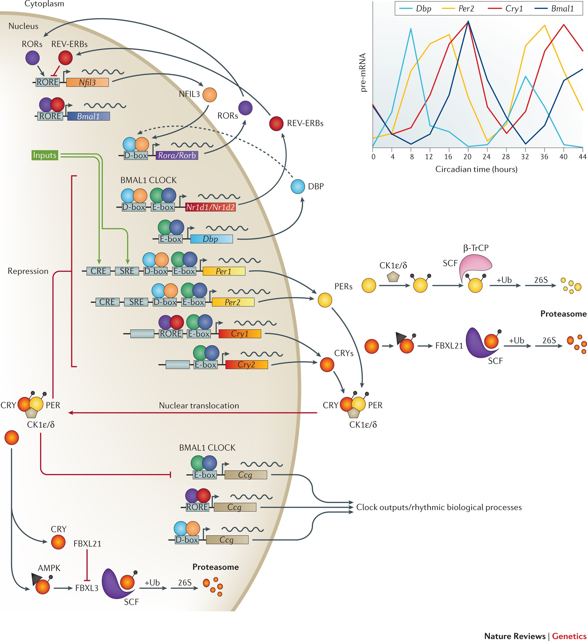
molecular clock
Takahashi, J. Transcriptional architecture of the mammalian circadian clock. Nature Reviews Genetics 18, 164-179 (2016).

Slide 22
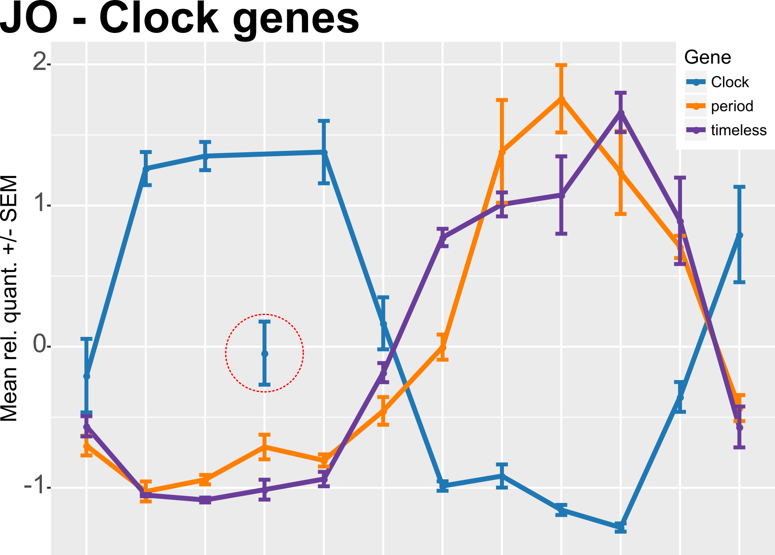
clock genes cycle in the antenna
2
1
unpublished data (Jason Somers)
mean rel. quant.±SEM
0
-1
ZT00
ZT02
ZT04
ZT06
ZT08
ZT10
ZT12
ZT14
ZT16
ZT18
ZT20
ZT22
zeitgeber time
Notes:
high-fidelity temporal information (time- or phase-locked signals), ITD ‘coincidence detection’, delay lines, topographic representation of azimuthal space

Slide 23
significance of Naam to auditory homeostasis and auditory circadian rhythms in Drosophila melanogaster
Notes:
In terms of background, four things to explain…

Slide 24
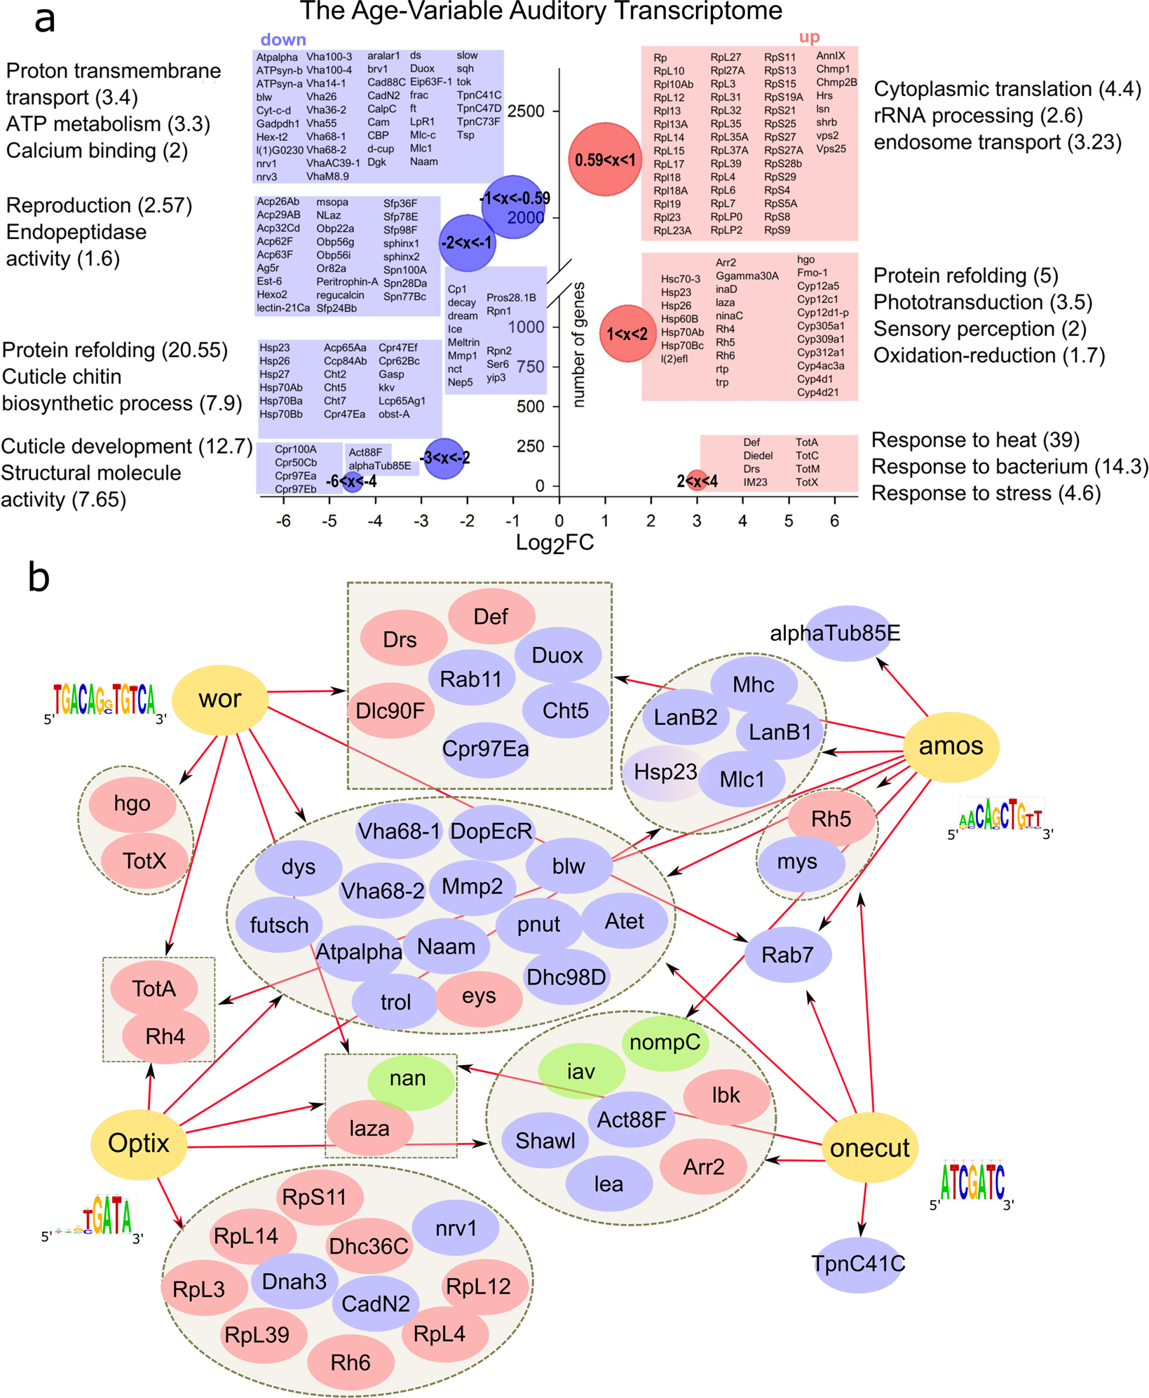
↓Naam is implicated in ARHL
Keder, A. et al. Homeostatic maintenance and age-related functional decline in the Drosophila ear. Sci Rep 10, 7431 (2020).

Slide 25
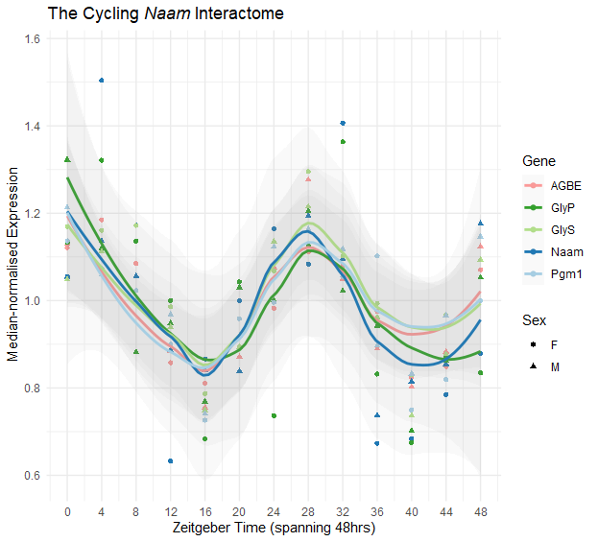
Naam cycles!
Unpublished data: RNA sequencing of JO at 4-hour intervals (each data point is the mean of a biological triplicate of 280 JOs) in the circadian day across 48h reveals oscillatory concentrations of Naam RNA products, indicating circadian-regulated transcription of Naam. AGBE, GlyP, GlyS, and Pgm1 were identified as Naam protein-interaction partners using the STRING protein association network database.

Slide 26
in summary
fruit fly hearing has a circadian rhythm
this rhythm may be a signature of auditory homeostasis
this rhythm is likely controlled by a peripheral antennal clock
Naam may play a role in the clock’s homeostatic control arms

Slide 27
h₁ Naam kd will affect auditory rhythm h₂ Naam kd will affect auditory function

Slide 28
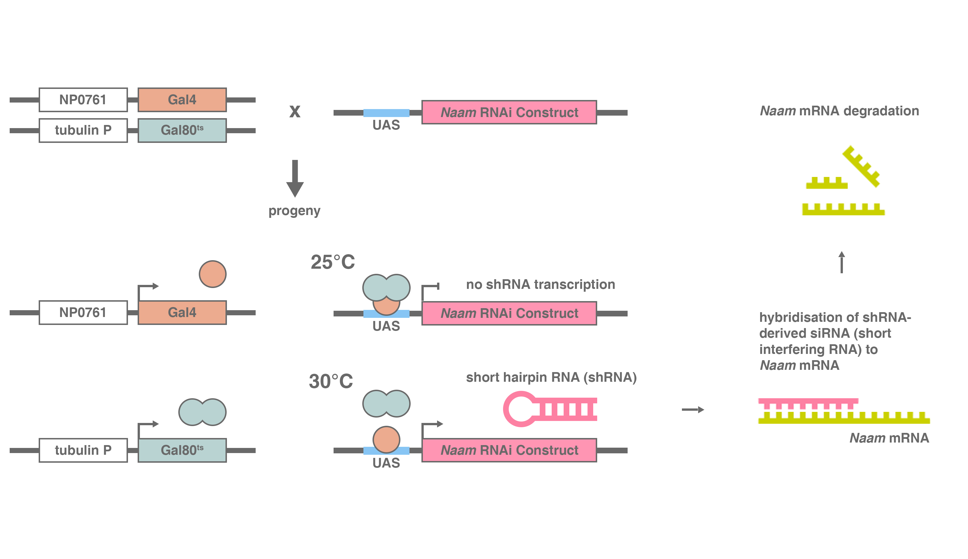

Slide 29
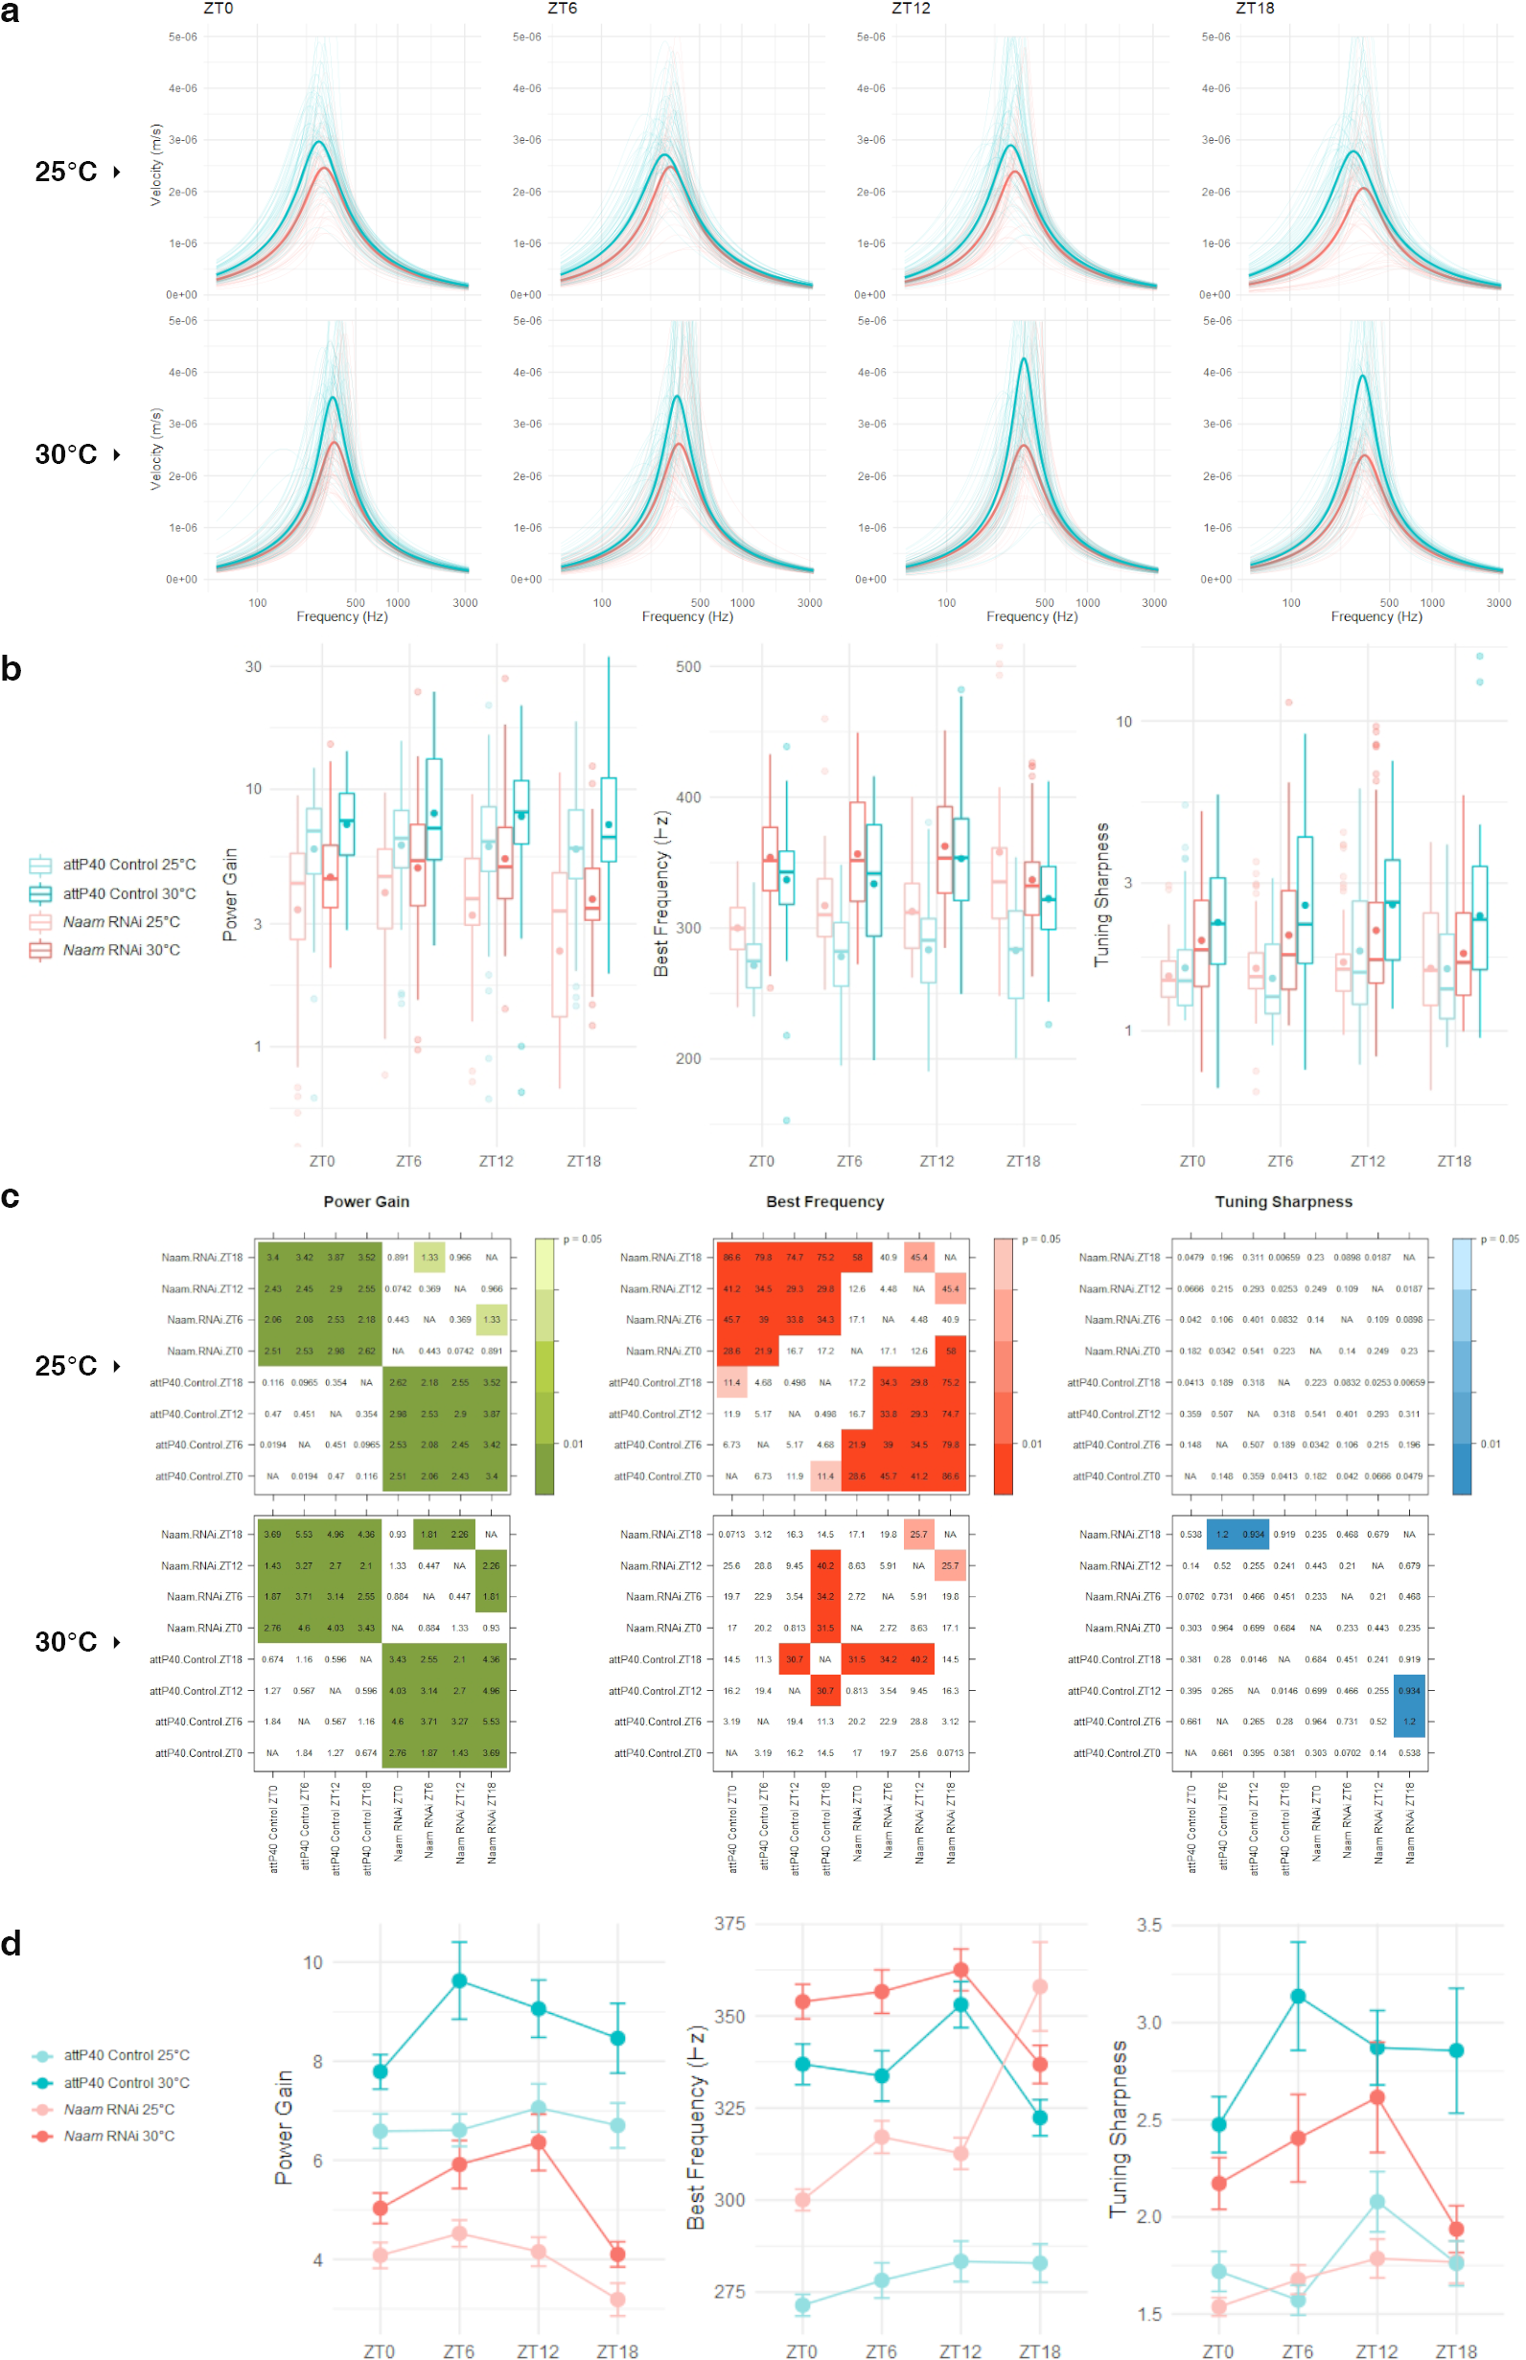
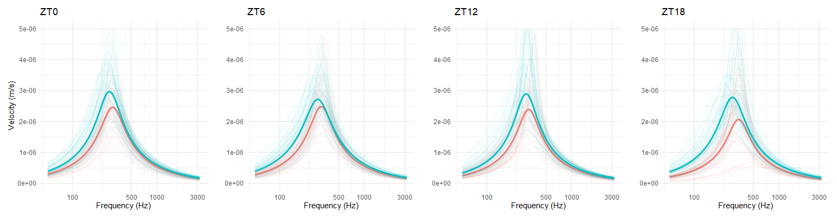
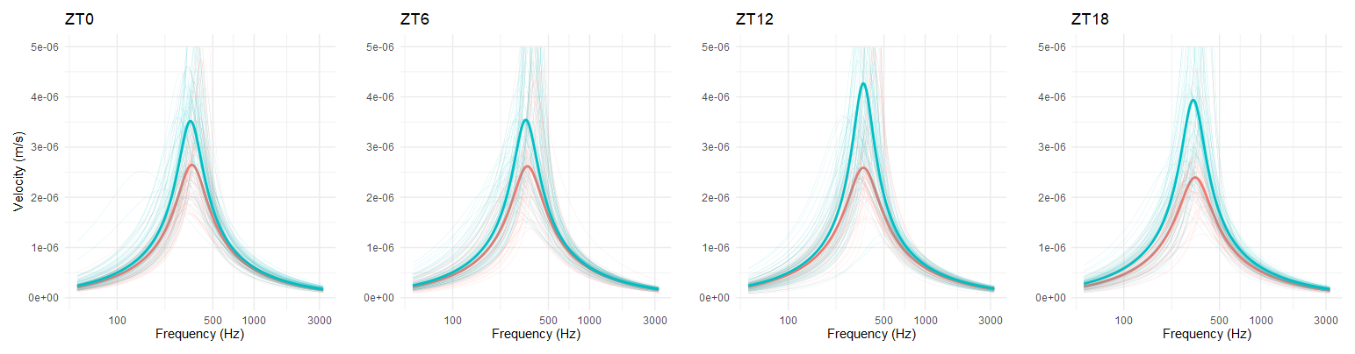

Slide 33
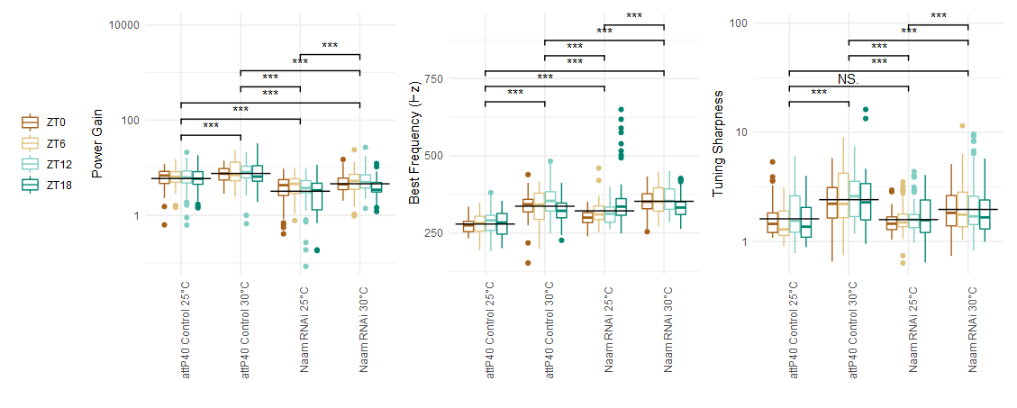

Slide 36
h₁ Naam kd will affect auditory rhythm h₂ Naam kd will affect auditory function

Slide 37
h₁ null refuted (small effect) h₂ null refuted (large effect)

Slide 38
discussion

Slide 39
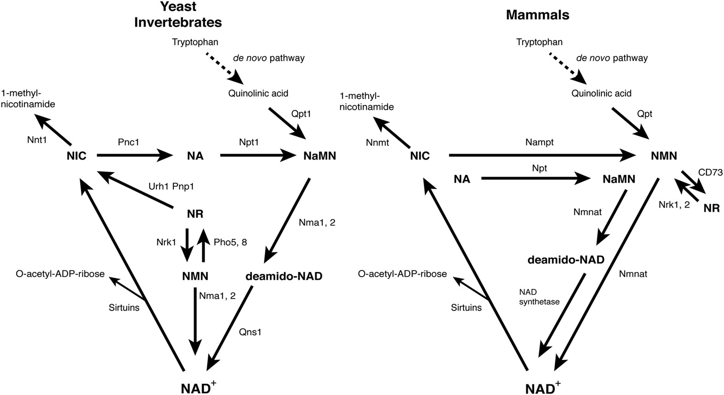
Naam
Imai, S. & Guarente, L. It takes two to tango: NAD+ and sirtuins in aging/longevity control. npj Aging Mech Dis 2, 1–6 (2016).

Slide 40
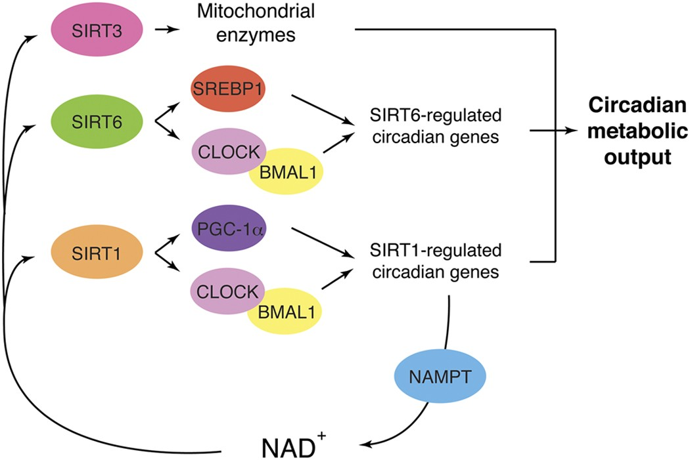
Nampt
Imai, S. & Guarente, L. It takes two to tango: NAD+ and sirtuins in aging/longevity control. npj Aging Mech Dis 2, 1–6 (2016).

Slide 41
thank you =)

Slide 42
transcription-translation feedback loop
gene ➞ mRNA ➞ protein

Slide 43
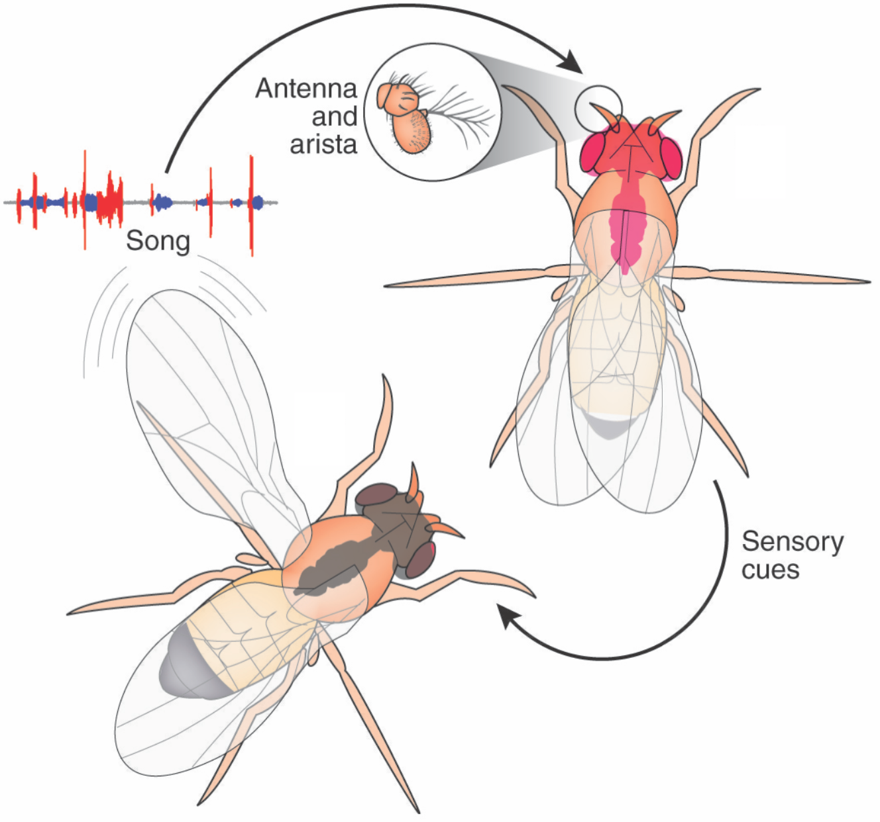
mating
Murthy Lab @ Princeton. Murthy Lab @ Princeton https://murthylab.princeton.edu/.
Notes:
Rhythm is antiphasic to mating rhythm

Slide 44
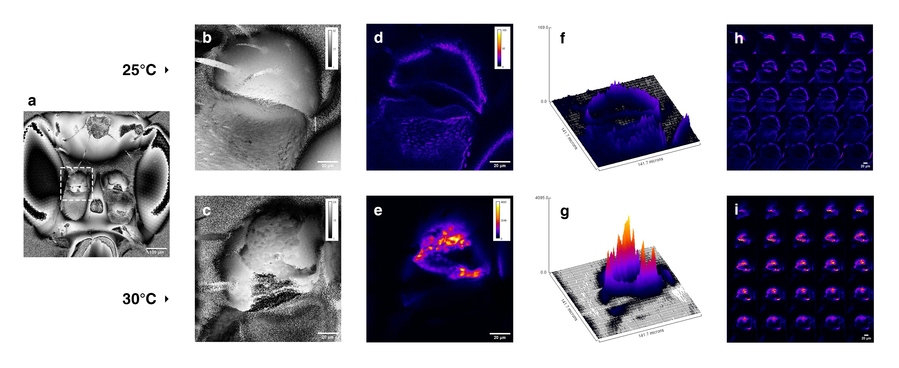
NP0761-Gal4>EGFP

Slide 45
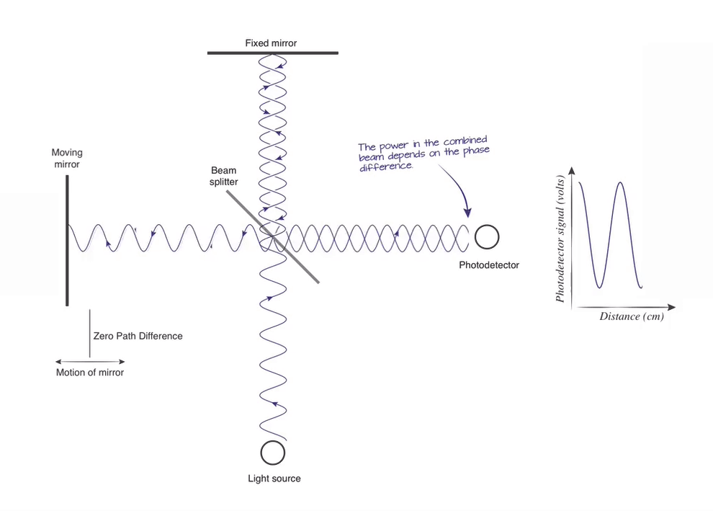
interferometry Interferometer GIF | Gfycat. Gfycat (2022). at <https://gfycat.com/impishthoughtfuleuropeanpolecat-interferometry>

Slide 46
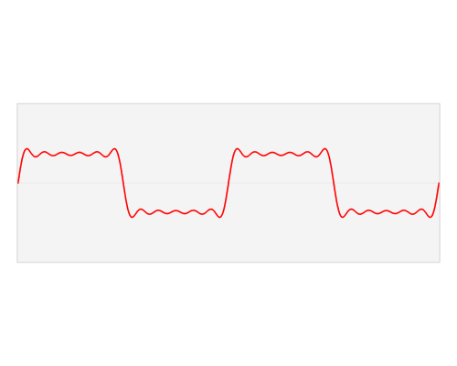
fourier transform File:Fourier transform time and frequency domains.gif - Wikimedia Commons. Commons.wikimedia.org (2022). at <https://commons.wikimedia.org/wiki/File:Fourier_transform_time_and_frequency_domains.gif>

Slide 47
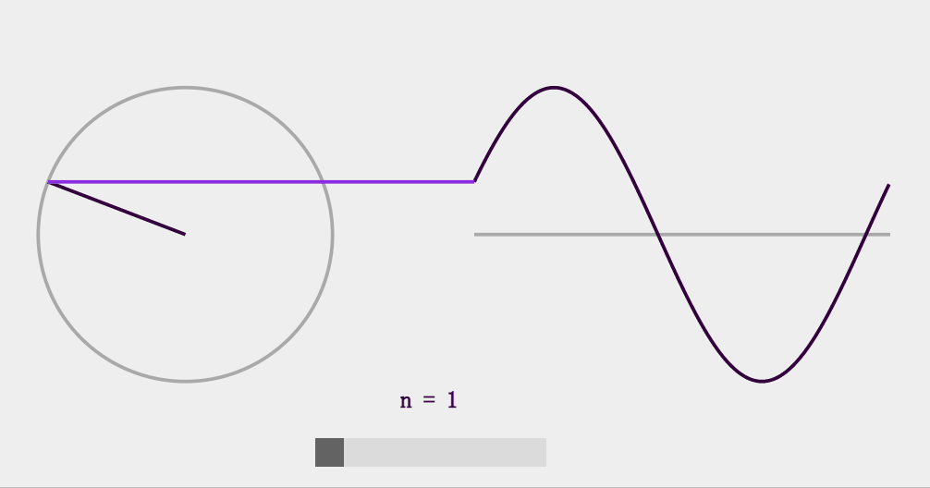
fourier transform Using Blender to run Python and visualizing Fourier Series. Medium (2022). at <https://contra.medium.com/using-blender-to-run-python-and-visualizing-fourier-series-a282663b972c>

Slide 48
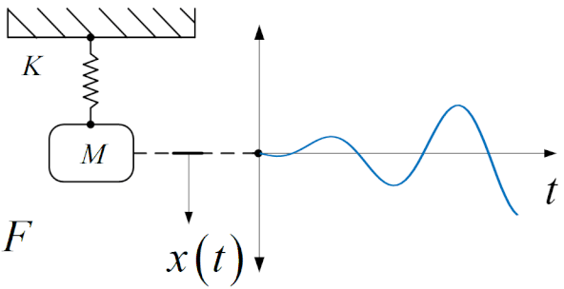
resonance: energy input rate > hysteretic energy dissipation Upload.wikimedia.org (2022). at <https://upload.wikimedia.org/wikipedia/commons/thumb/0/00/Mass_Spring_System_Resonance.gif/640px-Mass_Spring_System_Resonance.gif>

Slide 49
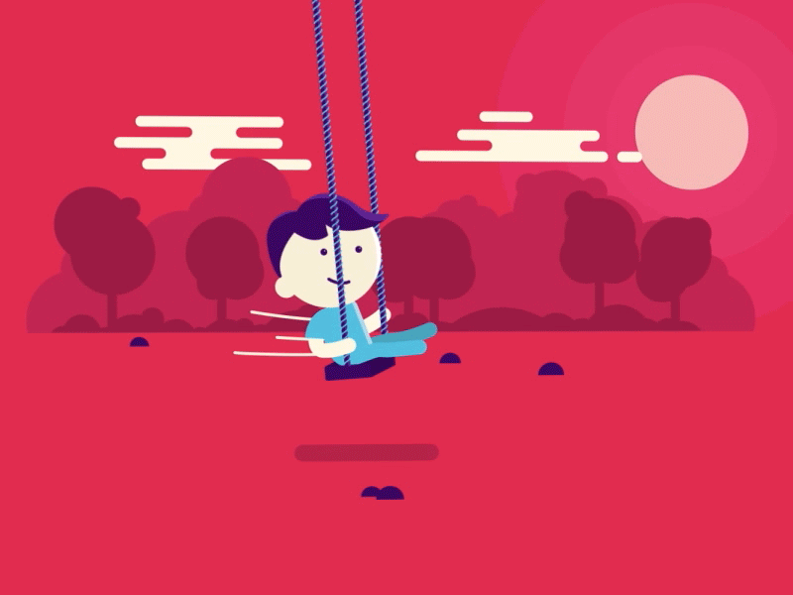
11.I.gifer.com (2022). at <https://i.gifer.com/origin/12/12b8318dfc116f1d68b6799b4fcb2ee7.gif>

Slide 50
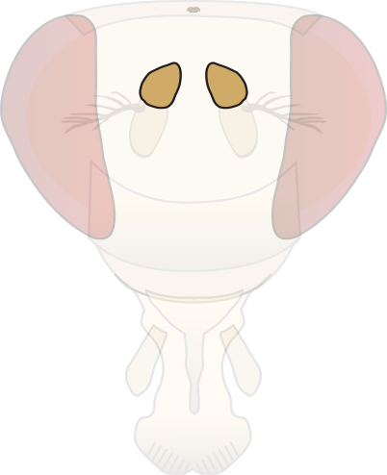
ZT00
ZT02
ZT04
ZT06
ZT08
ZT10
ZT12
ZT14
ZT16
ZT18
ZT20
ZT22

Slide 51
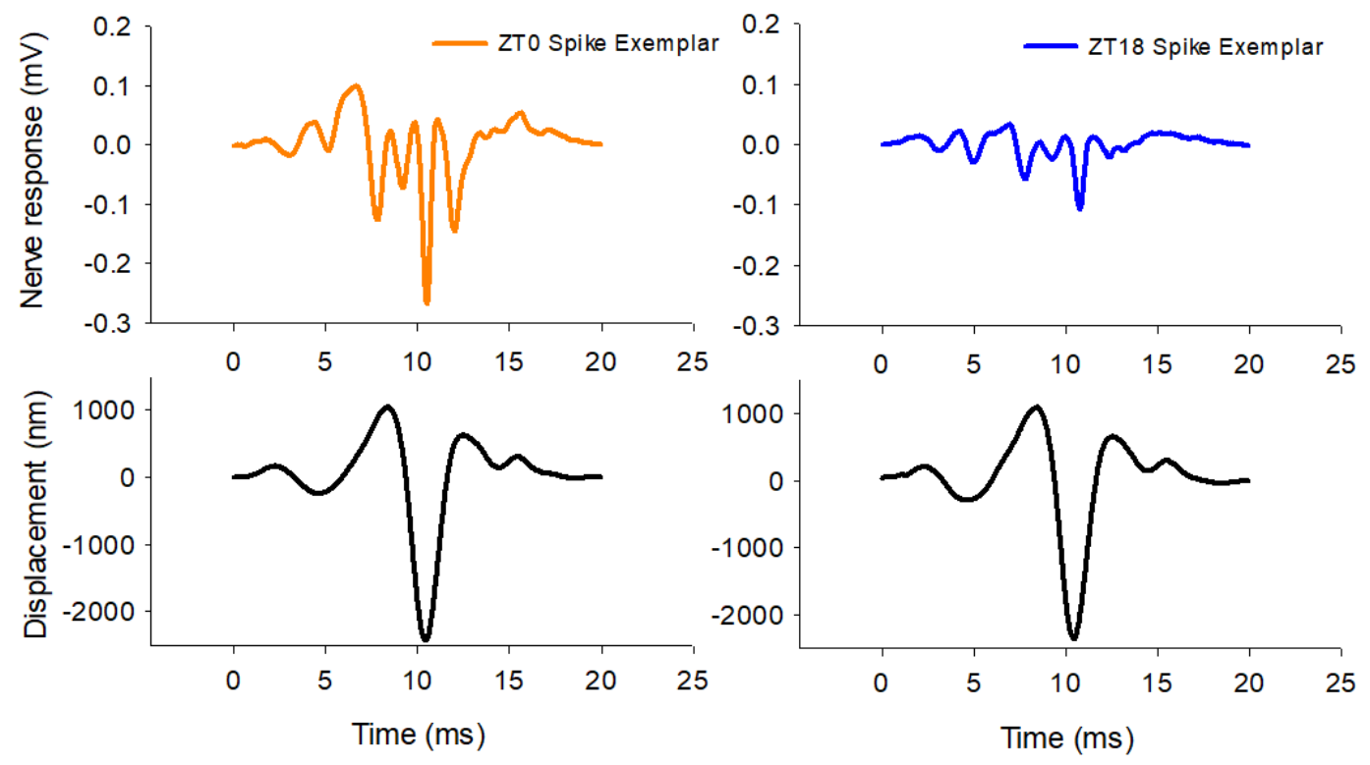
auditory nerve response changes with circadian time
Sudland, O. Circadian modulation in the antennal ear of Drosophila melanogaster. (University College London, 2021).
Notes:
high-fidelity temporal information (time- or phase-locked signals), ITD ‘coincidence detection’, delay lines, topographic representation of azimuthal space

Slide 52
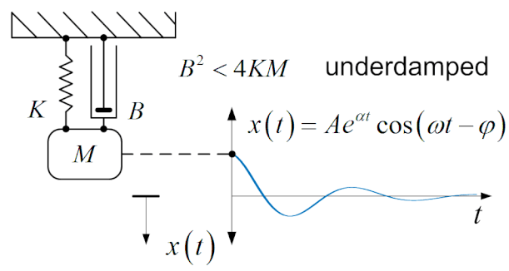
Mass Spring Damper System Underdamped.gif - Wikimedia Commons. Commons.wikimedia.org (2022). at <https://commons.wikimedia.org/wiki/File:Mass_Spring_Damper_System_Underdamped.gif>

Slide 53
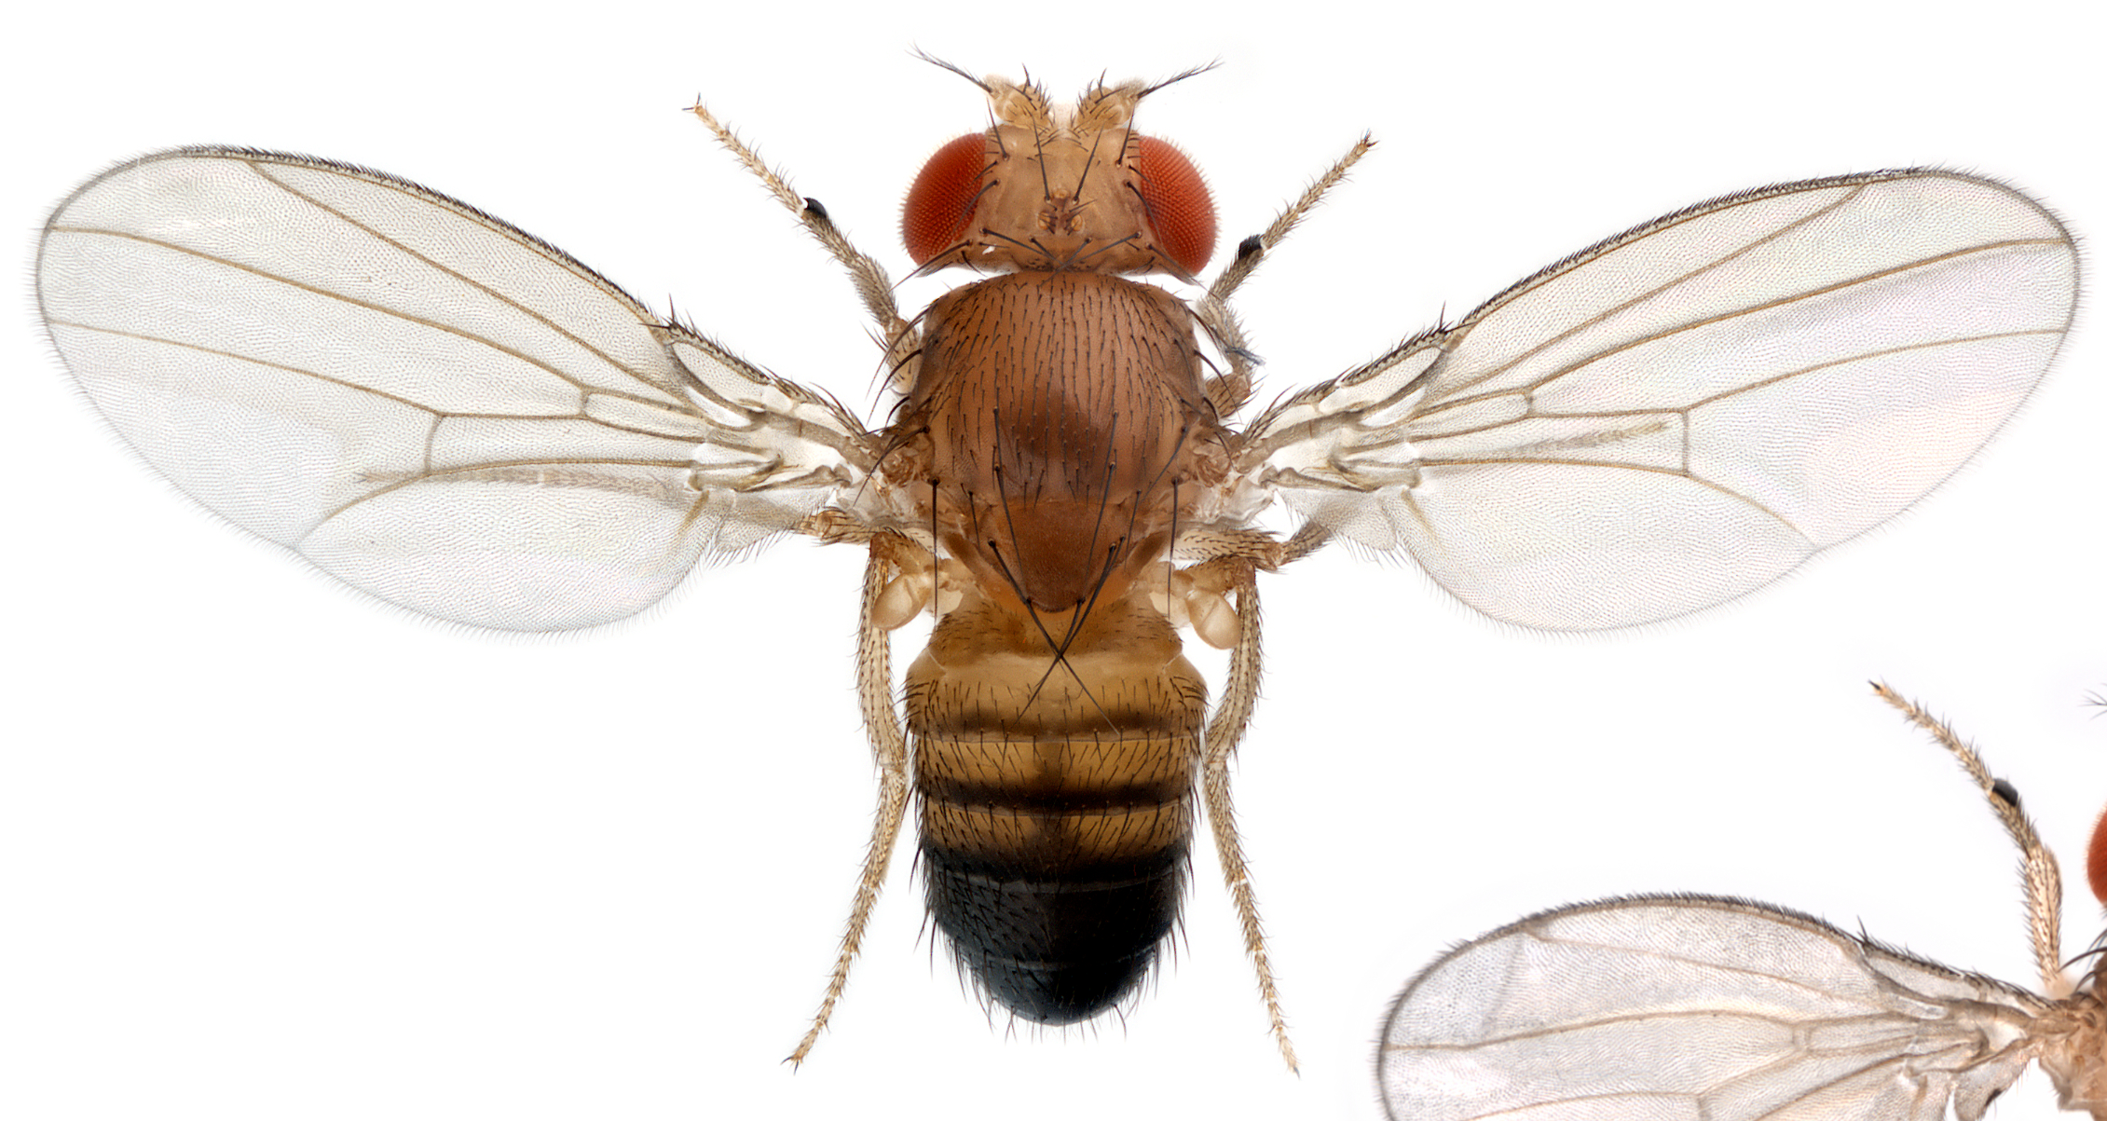
Drosophila melanogaster Flies with Four Wings? Investigating Genes that Pattern Animal Bodies. Zuckermaninstitute.columbia.edu (2022). at <https://zuckermaninstitute.columbia.edu/flies-four-wings-investigating-genes-pattern-animal-bodies>

Slide 54
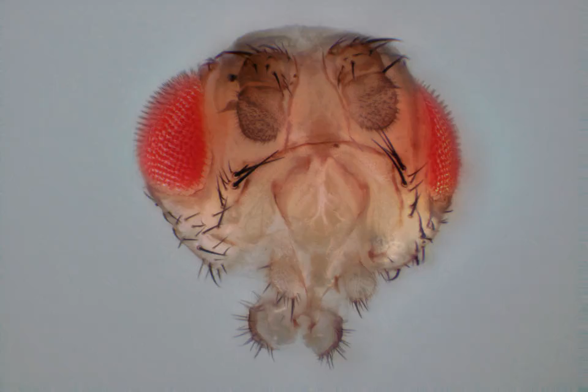
Reddit.com (2022). at <https://www.reddit.com/r/labrats/comments/e8lnbt/for_all_the_drosophila_peeps_a_3d_fly_head_wiggle/>

